Slide 1
Lecture 16: Communication Protocols
Communication protocols definition:
Protocols are rules and procedures for communicating.
Data is exchanged between devices during communication, so there should be procedures and standards to follow.
Protocols are many and each protocol facilitates basic communication.

Slide 2
Communication protocols
Each protocol is used for different purposes and it also accomplishes different tasks.
Some protocols work only at particular OSI layers, so the layer at which a particular protocol works/operates describes its function, for example a protocol that works at the physical layer ensures that data packets passes through the network interface card(NIC) and out onto the network cable.

Slide 3
Communication protocols
Protocols can also work together as a suite, for example the TCP/IP protocol’s application layer maps to the OSI reference model’s presentation layer.

Slide 4
How protocols work
The entire technical operation by which data is transmitted over the network is broken down into discrete, systematic steps.
At each step certain actions take place which cannot take place at any other step.
Each step includes its own rules and procedures or protocol.

Slide 5
Data is transmitted between a transmitter (source) and receiver.
Below is a sequence of steps taken by a sending computer.

Slide 6
Sending computer
The Sending computer
1.Breaks data into small sections called packets which the protocols can handle.
2.Add addressing information to the packets so that the destination computer can determine that the data belongs to it.
3.Prepare the data for transmission through the network interface card, through the network interface card (NIC) onto the network

Slide 7
The receiving computer
Protocols at the receiving computer carry out the same series of steps but in the reverse order
1.Take the packets off the cable
2.Bring data packets into the computer through the NIC
3.Strip the packets of all the transmission information that was added by the sending computer
4.Copy the data from the packets to the buffer for re-assembly
5.Pass the reassembled data to the application in a usable form

Slide 8
Open System Interconnection model (OSI)
The OSI is a conceptual and logical layout that defines network communication used by systems open to interconnection and communication with other systems.
OSI was proposed by ISO in 1977 to provide solutions to many problems encountered during transmission from source to destination.

Slide 9
OSI
OSI model breaks down problems involved in moving data from source to destination or from one computer to another and categorize them into seven layers.
A layer in OSI model is a portion used to categorize specific problems.
The seven layers are:

Slide 10
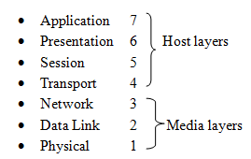
The seven OSI layers

Slide 11
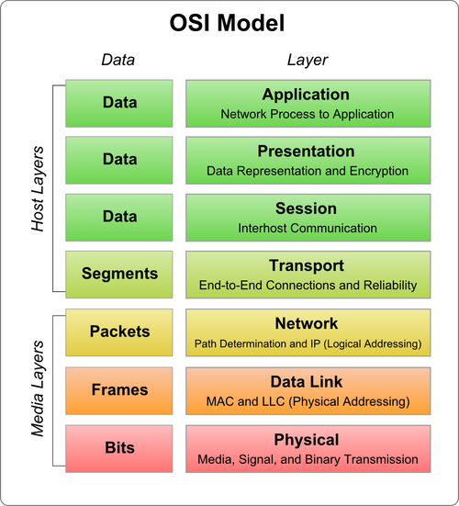
OSI Model and functions

Slide 12
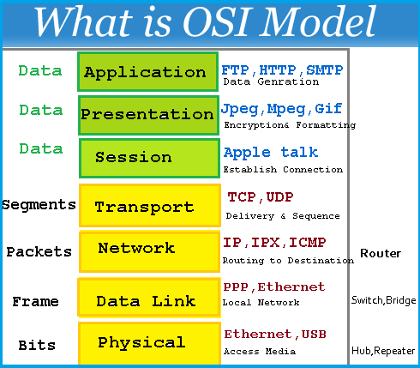
Specific functions performed by specific protocols

Slide 13
Layers functions and protocols
Application layer
Shows the spot where users actually communicate.
Purpose is to manage communication between applications and end user processes.
Prime examples include:
File transfers and emails
Remote access
Network management activities
Client/server processes and information locations
Applications request and data reception.

Slide 14
Protocols used in the application layer
Protocols used in the application layer include:
File Transfer protocol (FTP)
Hyper-text transfer protocol(HTTP)
Hyper text transfer protocol secure(HTTPs)
Simple Mail Transfer Protocol (SMTP)

Slide 15
Protocols used in the application layer
BitTorrent – protocol for distributing files
DNS (Domain Name System) – used to translate domain names to numerical IP addresses
NetBIOS (Network basic input/output system) which provide services related tot he session layer of the OSI model. It normally runs over TCP/IP.

Slide 16
Presentation layer
The presentation layer does the following:
Presents data to the application layer
Responsible for data translation, code formatting
Primary function is to define data formats such as texts, ASCII, binary and Jpeg
Adds structure to the packets of the data that is being exchanged and makes sure that the data is being transmitted in a format or syntax that the receiving system is able to understand. Data encryption is also defined in this layer.

Slide 17
Presentation layer protocols
Hypertext Transfer Protocol(HTTP)
Multipurpose Internet Mail Extensions(MIME)
File Transfer Protocol (FTP)
Network News Transfer Protocol (NNTP)

Slide 18
Session layer
This layer is responsible for:
setting up, managing and tearing down sessions between presentation layer and entities.
provides dialogue between devices, or modes.
defines how to start/establish a connection

Slide 19
Example:
The web browser opens a web page.
Page contains text, graphics, macromedia, flash objects and sometimes applets.
These are all stored as separate files on the web server.
To access them a separate download must be started. The web browser opens separate sessions to the web server to download each of the individual files.

Slide 20
Protocols used in session layer
Protocols used in the session layer are:
Network File System(NFS)- used to provide remote access to shared file systems across networks
Server Message Block (SMB)- which provides a method for client applications in a computer to read and write to files and to request services from server programs in a computer network. SMB can be used over the Internet on top of TCP/IP protocol or on top of other protocols such as Internet packet exchange.

Slide 21
Transport layer
The transport layer performs the following functions:
Assures reliable arrival of messages
Provides error checking mechanism and data flow
Serves both connection mode transmission and connectionless mode transmission.

Slide 22
Connection oriented mode- a communication session or semi-permanent connection is established before any useful data can be exchanged transferred.
Connection-less – examples include datagram mode of communication used by IP and UDP protocols, where data may be delivered out of order.

Slide 23
Connection oriented can be circuit switched connection or packed mode virtual circuit connection
. E.g. ATM asynchronous transfer mode. Most common or well known is the control protocol (TCP).

Slide 24
Network layer
The network layer is responsible for the following:
Manages device addressing
Traces the location of devices on the network
Determines the best route to move the data
Defines how to fragment a packet into smaller packets so that it can be accommodated in the transmission media

Slide 25
Protocols used in the network layer
Protocols used in the network layer include:
Enhanced Interior Gateway Routing protocol
Internet control message protocol(ICMP)
Internet Group Management protocol(IGMP)
Internet Control Message Protocol(ICMP)
Internet Protocol version 4 (IPV4)
Integrated Protocol version 6
Internet Protocol security(IPV6

Slide 26
Data Link Layer
The data link layer provides the following functions in the OSI model:
Provides physical transmission of data and handles error notifications and flow control
Makes sure that messages are delivered to the correct device on a LAN using hardware addresses and translates the messages from the network layer into bits for the physical layer to transmit
Formats messages into data frames and adds customized header containing the hardware destination and source addresses.

Slide 27
Data link layer subdivisions
The data link layer is made up of two layers:
Logical Link Control (LLC) sub layer
Primary functions of the LLC are:
- multiplexing
- flow control

Slide 28
Media Access Control (MAC) sub layer
Main functions of the MAC sub layer are:
provides addressing and channel access control mechanisms that make it possible for several terminals or network nodes to communicate within a multipoint network, typically a local area network (LAN)"

Slide 29
Media access control
Provides the physical specifications of communication between devices over a network.
Under MAC, every device on a network has a physical address that identifies it to the rest of the network.

Slide 30
Physical Layer
Physical layer is the lowest layer of all. It is responsible for sending bits from one computer to another. This layer is not concerned with the meaning of the bits and deals with the physical connection to the network and with transmission and reception of signals.
This layer defines electrical and physical details represented as 0 or a 1. How many pins a network will contain, when the data can be transmitted or not and how the data would be synchronized.

Slide 31
The physical layer functions are:
Representation of Bits: Data in this layer consists of stream of bits. The bits must be encoded into signals for transmission. It defines the type of encoding i.e. how 0's and 1's are changed to signal
Data Rate: This layer defines the rate of transmission which is the number of bits per second
Synchronization: It deals with the synchronization of the transmitter and receiver. The sender and receiver are synchronized at bit level
Interface: The physical layer defines the transmission interface between devices and transmission medium

Slide 32
Physical layer functions
Line Configuration: This layer connects devices with the medium: Point to Point topologies: Devices must be connected using the following topologies: Mesh, Star, Ring and Bus
Transmission Modes: Physical Layer defines the direction of transmission between two devices:

Slide 33
Physical layer transmission modes
Transmission Modes:
Simplex
Half Duplex,
Full Duplex
Deals with baseband and broadband transmission

